Slide 1
How to get started learning how to code
Crack the Code 2016

Slide 2
Why Start?
“I think everyone should get a little exposure to computer science because it really forces you to think in a slightly different way, and it’s a skill that you can apply in life in general, whether you end up in computer science or not” - Tony Hsieh
“Software touches all of these different things you use, and tech companies are revolutionizing all different areas of the world...from how we shop to how farming works, all these things that aren't technical are being turned upside down by software. So being able to play in that universe really makes a difference” - Drew Houston
“Coding is today’s language of creativity. All our children deserve a chance to become creators instead consumers of computer science” - Maria Klawe

Slide 3
What do you wish you knew before you got started coding?
“Be more fearless and break your computer. You learn the most in the debugging” – Tanya Tarr
“Learning a new pattern is much more valuable than a new language” – Travis Hoppe
“Even the most experienced Developers utilize a lot of trial and error. Struggling through code and asking google is natural” – Nicholas Marcouiller

Slide 4

My Story

Slide 5
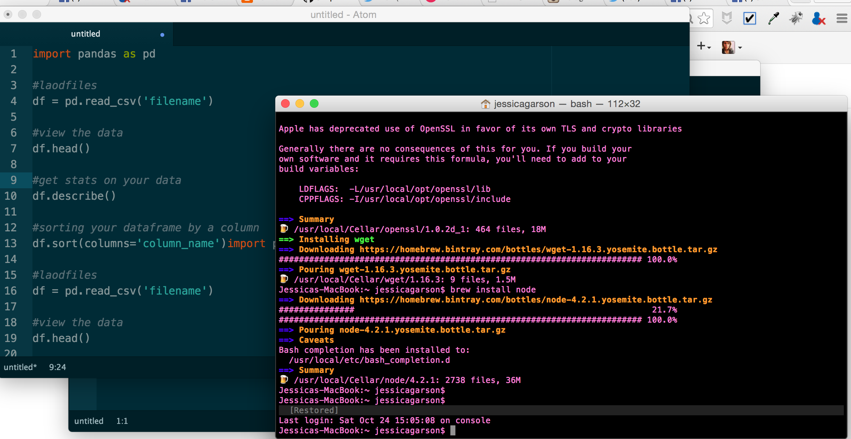
What do you need to code?

Slide 6
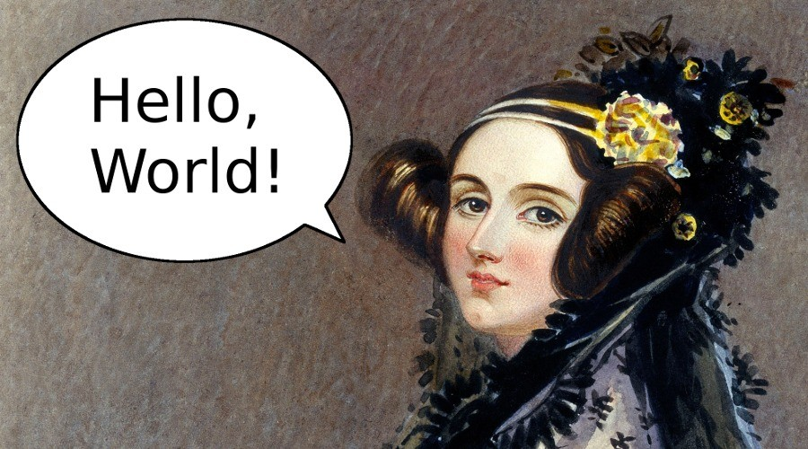
Where do I start

Slide 7
Steps to learning
Start with command line basics and choose a language based on you are looking to do next
Build something cool that interests you – this may be hard when you don’t know what you are capable of but anything that makes your day to day job easier or a personal site are usually good places to get started

Slide 8
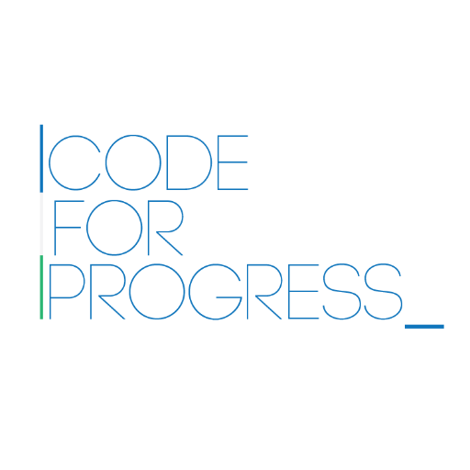
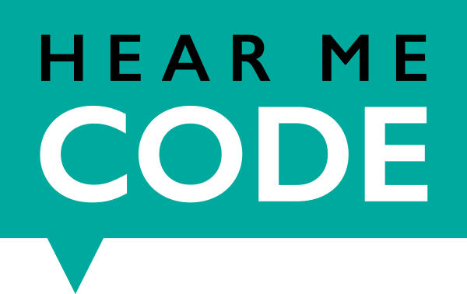

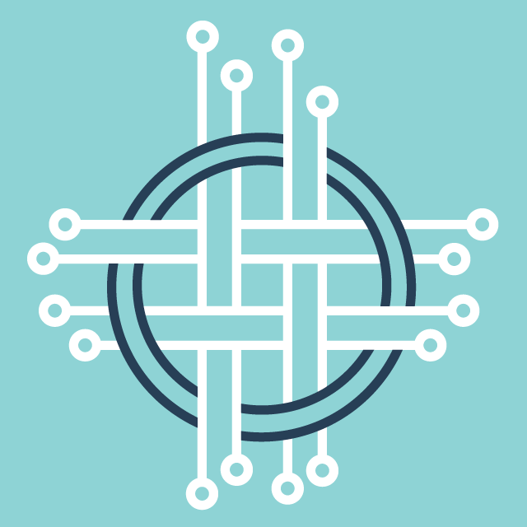


The coolest thing about DC right now

Slide 9
A few resources I recommend

Slide 10
Contact
Jessica Garson
Jessica.Garson@gmail.com
Jessica.Garson@bm.com
Zine - http://bit.ly/whatsmyfunctionzine
Twitter: @jessicagarson

